Slide 1
Aegis.AI
AI Governance Platform
FYP Phase 1 Presentation
Team Members: Muhammad Haris (F2022376040) • Ahmed Abdullah Khan (F2022376096) • Farhana Minhas (F2022376126)
Supervisor: Supervised by: Sir Usama Ahmad
Institution: Department of AI & Data Science, SST, UMT
Date: March 2026

Slide 2
Agenda
01
Introduction
02
Problem Statement & Objectives
03
Domain Analysis & System Architecture (C4 L1→L3, ERD, DFD)
04
Product Backlog & Scrum Methodology
05
Figma Prototype Designs
06
Live Demo — VS Code & Project Structure
07
Live Demo — Running Platform (10+ modules)
08
Algorithms Deep Dive
09
Data Dictionary & Approval Sequence
10
Sprint Highlights (All 9)
11
Results & Statistics
12
Conclusion & Future Work

Slide 3

Why AI Governance is Broken Today
1. Regulatory Complexity
2. No Centralized
Oversight
3. No Self-Hostable Alternative
EU AI Act + ISO 42001 + ISO 27001 + NIST AI RMF = hundreds of controls to track simultaneously
AI models, risks, vendors, and policies managed in disconnected spreadsheets
Existing tools are cloud-only SaaS (Credo AI, OneTrust) — unaffordable for SMEs
4. Manual, Error-Prone Audits
5. No Built-In AI Safety Evaluation
Time-consuming, inconsistent, not repeatable
No integrated LLM benchmarking, bias detection, or AI code scanning
There is a need for a comprehensive, self-hostable AI governance platform.

Slide 4






What Aegis.AI Set Out to Do
Support EU AI Act, ISO 42001, ISO 27001, NIST AI RMF from one interface
AI Model Inventory with risk assessment & version tracking
AI Advisor — LLM-powered governance chatbot
LLM Evaluations & Arena for model benchmarking
AI Detection Module — scan GitHub repos for AI-generated code
Multi-tenancy with complete per-tenant data isolation

Slide 5
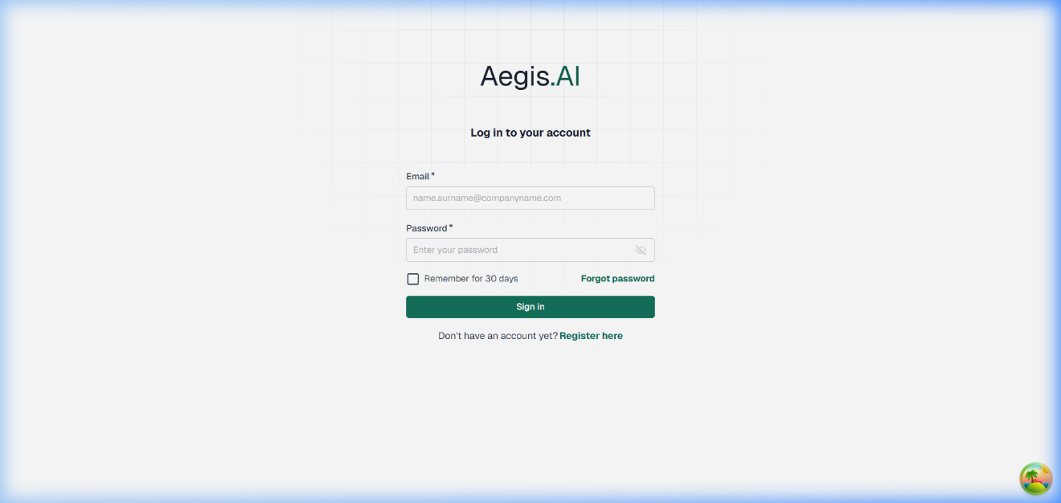

Who Is Aegis.AI For?
Customers
Stakeholders
🏭 Technology companies needing EU AI Act compliance
🏥 Enterprises in finance, healthcare, manufacturing, public sector
🏛️Government bodies requiring AI transparency and oversight
Role
Description
Admin
Full platform control
Editor
Day-to-day governance work
Reviewer
Reviews submissions, approves/rejects
Auditor
Read-only; generates compliance reports
System
Background jobs (PMM, automation, email)
Platform is self-hosted — suitable for data sovereignty and air-gapped environments.

Slide 6
How Aegis.AI Compares to Existing Solutions
Feature
Credo AI
IBM OpenScale
Holistic AI
OneTrust AI
Aegis.AI
EU AI Act Support
—
—
—
—
✅
ISO 42001
Partial
—
Partial
—
✅
ISO 27001
—
—
—
—
✅
NIST AI RMF
—
Partial
Partial
Partial
✅
LLM Evaluations
—
Partial
—
—
✅
AI Detection Module
—
—
—
—
✅
On-Premises Deploy
—
—
—
—
✅
Multi-Tenancy
—
—
—
—
✅

Slide 7



Technical Architecture — PERN + Python
React + TypeScript Frontend
Node.js + Express Backend
PostgreSQL
Material UI, React Router, Zustand state
Clean Architecture, Repository Pattern, Sequelize ORM
Schema-per-Tenant + Redis (BullMQ)
Frontend
Backend
React 18, TypeScript, Material UI, Zustand
Node.js, Express.js, TypeScript, Sequelize ORM
Database
Evaluation Server
PostgreSQL (schema-per-tenant multi-tenancy) + Redis
Python, FastAPI, DeepEval
Auth
Deployment
JWT + RBAC (4 roles: Admin, Editor, Reviewer, Auditor)
Docker Compose + Kubernetes

Slide 8
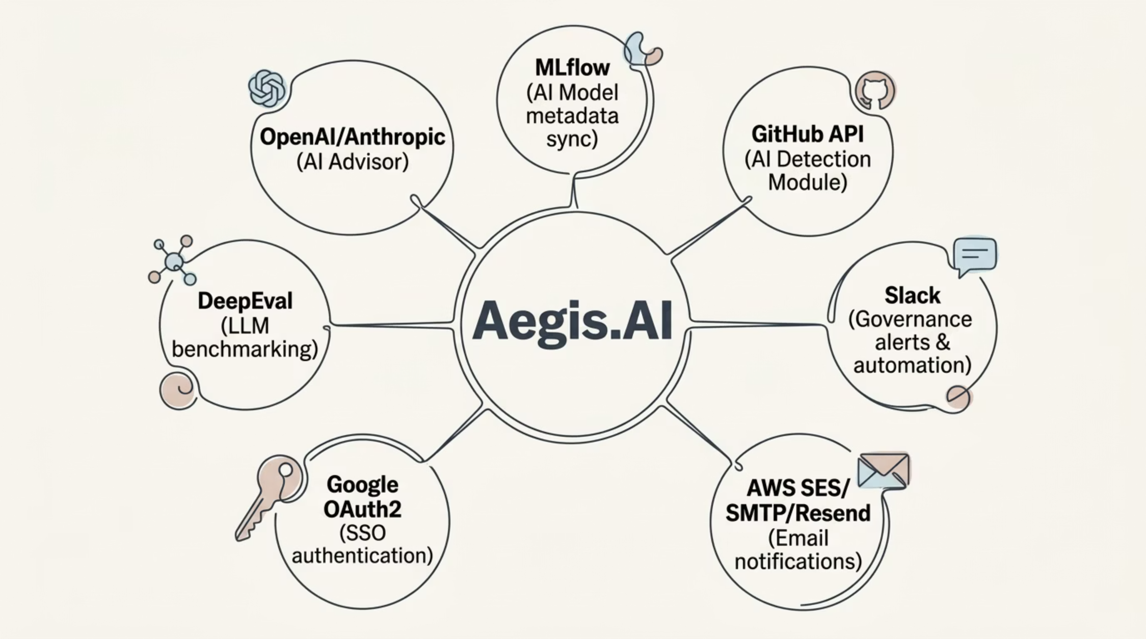

External Integrations
All integrations are optional & modular — platform runs fully offline if needed.

Slide 9

Product Backlog — 58 User Stories | 20 EPICs
43
15
58
230
FYP 1 (Phase 1) — Total User Stories
FYP 2 (Future) — Total User Stories
Total User Stories
FYP 1 (Phase 1) — Story Points
114
344
FYP 2 (Future) — Story Points
Total Story Points
74% (43 stories) Done — Green
26% (15 stories) Planned — Amber
Epic highlight bullets:
User Management & RBAC ✅
Multi-Tenancy & Org Management ✅
Approval Workflows ✅
Framework Management (EU AI Act,
ISO 42001, ISO 27001,
NIST AI RMF) ✅
Risk, Vendor, Policy, Model Inventory ✅
LLM Evaluations, AI Advisor, AI Detection (Planned)
·74.14%
Done·74.14%
·
·
Planned·25.86%
·25.86%

Slide 10
9 Sprints | 5 Months | November 2025 — March 2026
Sprint
Dates
Goal
Scrum Master
Sprint 1
Nov 15–28
Foundation & Authentication
Muhmmad Haris
Sprint 2
Dec 1–14
Multi-Tenancy & Approvals & SSE
Abdullah Ahmad Khan
Sprint 3
Dec 15–28
EU AI Act Framework
Farhana Minhas
Sprint 4
Jan 2–15
ISO 42001 & ISO 27001
Muhammad Haris
Sprint 5
Jan 16–29
Risk Management
Ahmad Abdullah Khan
Sprint 6
Feb 1–14
Vendor, Policy, Tasks
Farhana Minhas
Sprint 7
Feb 15–28
AI Model Inventory & NIST AI RMF
Muhammad Haris
Sprint 8
Mar 1–7
LLM Evals UI & AI Advisor UI
Ahmad Abdullah Khan
Sprint 9
Mar 8–20
Reporting, Evidence Hub, Search, AI Trust Center
Farhana Minhas

Slide 11
Team Member Contributions
🔵 Muhammad Haris
🟠 Ahmed Abdullah Khan
🟣 Farhana Minhas
Core Infrastructure & Backend
DevOps, Compliance & Architecture
Frontend, UI/UX & Testing
Monorepo architecture setup
JWT authentication & token refresh logic
Sequelize ORM & database migrations
Approval Workflows engine (multi-step state machine)
Risk Management backend & auto-scoring algorithm
Post-Market Monitoring (BullMQ scheduling)
Global Search (14 entity types + Command Palette)
Scrum Master: Sprints 1, 4, 7
Docker Compose & Kubernetes manifests (8 manifests incl. HPA)
RBAC middleware (4-role permission system)
EU AI Act module (13 control categories, ~60 controls)
ISO 42001 (AIMS) & ISO 27001 (ISMS) modules
NIST AI RMF (4 functions, ~70 subcategories)
AI Model Inventory backend + MLflow integration
SSE notification system with Redis Pub/Sub
DOCX report generation
Scrum Master: Sprints 2, 5, 8
React 18 component architecture (50+ pages)
Login, Registration, and Onboarding UI
Vendor Management & Policy Manager UI
WatchTower Event Tracker frontend
Reporting & PDF/DOCX export UI
Figma UI/UX prototypes (20 screens)
Test case documentation & UAT execution
Scrum Master: Sprints 3, 6, 9

Slide 12
What We Built — Sprint by Sprint
Sprints
Key Deliverables
Auth, RBAC, Multi-tenancy, Approval Workflows, SSE notifications
1–2
EU AI Act, ISO 42001, ISO 27001, NIST AI RMF compliance modules
3–4
Risk Management (auto-scoring), Vendor Management, Policy Manager, Tasks
5–6
AI Model Inventory, NIST framework completion, LLM Evals UI, AI Advisor UI
7–8
Reporting (PDF/DOCX), Evidence Hub, Global Search, AI Trust Center, WatchTower, Incidents
9–10
11
Post-Market Monitoring (PMM), Automation scaffolding

Slide 13
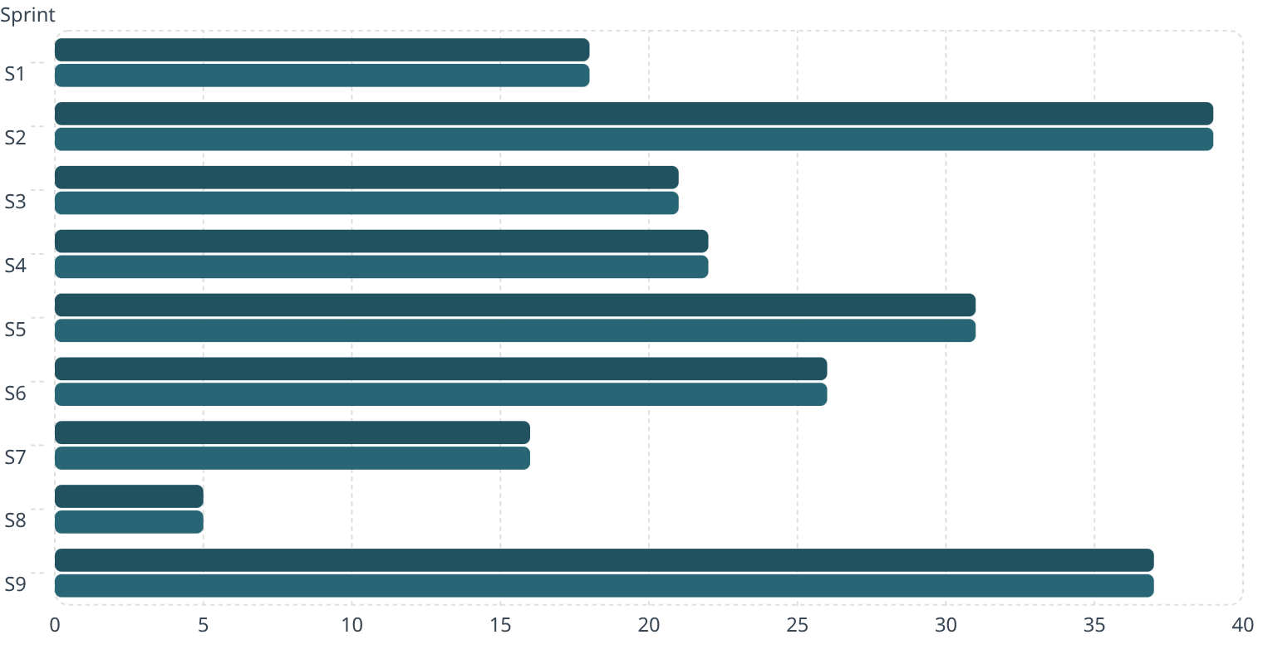
Sprint Velocity — Phase 1
Committed
Delivered
100% delivery rate — 230 total story points delivered across 9 sprints

Slide 14
Live Demo
🖥 Switching to Live Application Demo
Running locally at: http://localhost:5173
Services active: Node.js Backend • React Frontend • PostgreSQL • Redis

Slide 15
Testing Results — Phase 1
UAT Summary
System Accuracy
Metric
Value
Area
Accuracy
Total Phase 1 User Stories
43
User Acceptance Testing
100%
Tested via Browser UAT
43
Risk Auto-Calculation
100%
Stories Passed
43
Multi-Tenant Isolation
100%
Pass Rate
100%
Approval Workflow Progression
100%
PMM Auto-Scheduling
100%
RBAC Permission Enforcement
100%
SSE Real-Time Notifications
98%
PDF Report Accuracy
93%
Overall System Accuracy
~99%

Slide 16

Platform Completion — Phase 1
43/58
43/43
15
🟢 User Stories Complete
🟢 Phase 1 Stories = 100%
🟠 Stories Planned for Phase 2
·
·74%
Complete·a%
·
Future·26%
·26%
Platform fully functional for Phase 1 scope. Phase 2 features require LLM API keys, SMTP, GitHub tokens.

Slide 17

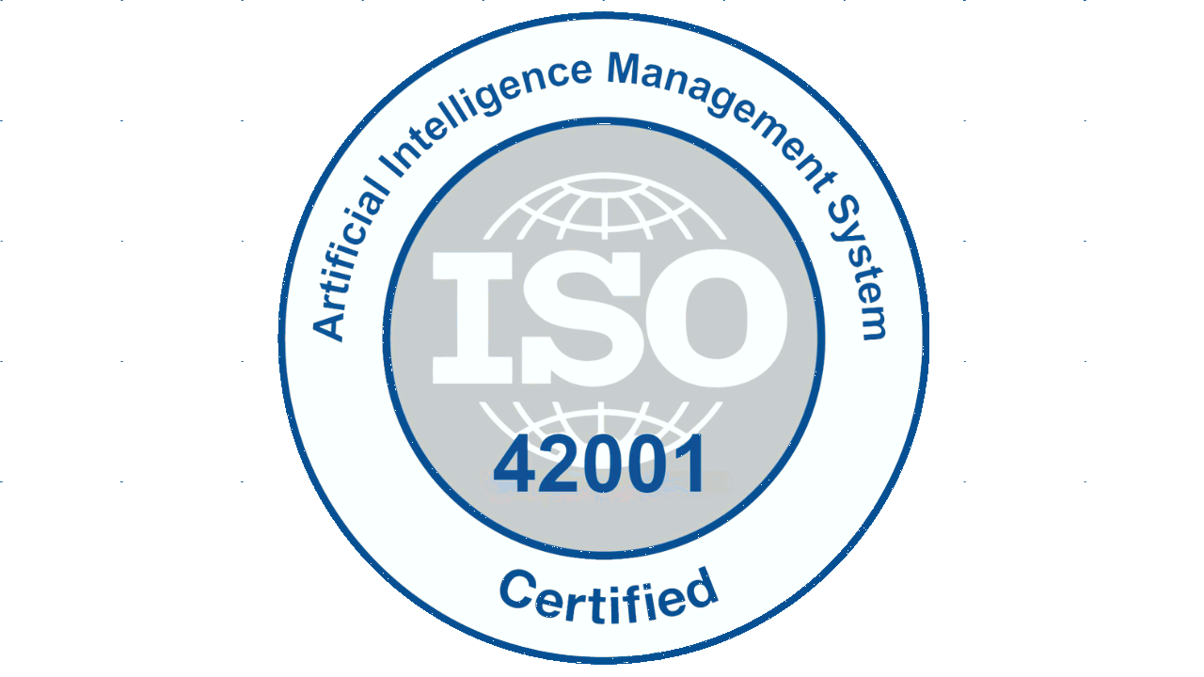

AI Compliance Framework Coverage
EU AI Act
ISO 42001
13 control categories, ~60 questionnaire controls
7 clauses, Annex A & B — 7-stage workflow per subclause
ISO 27001
NIST AI RMF
7 clauses, 93 Annex A controls — implementation tracking
4 functions (Govern/Map/Measure/Manage), ~70 subcategories
Each framework card with official logo/flag icon and a green ✅ badge

Slide 18
What We Achieved in FYP Phase 1
✅ Built a fully functional, self-hostable AI Governance Platform from scratch
✅ 43 user stories across 20 EPICs delivered and tested — 100% UAT pass rate
✅ Complete coverage of EU AI Act, ISO 42001, ISO 27001, and NIST AI RMF
✅ No comparable open-source self-hostable product provides this scope of features
✅ Clean Architecture, Docker + Kubernetes deployment, Multi-tenancy fully operational
✅ ~99% overall system accuracy across all measured areas
Aegis.AI democratizes AI governance for organizations that cannot afford enterprise SaaS tools.

Slide 19
What's Next — FYP Phase 2
(15 User Stories | 114 Story Points)
Number
Feature
Requirement
1
AI Advisor with live LLM API
OpenAI / Anthropic key
2
LLM Evaluations & Arena (DeepEval)
EvalServer + API key
3
AI Detection Module (GitHub scanning)
GitHub token
4
Bias & Fairness Evaluation
EvalServer + LLM key
5
Email Notifications (password reset, PMM)
SMTP / AWS SES
6
Slack Automation integration
Slack webhook
7
MLflow model sync
MLflow instance
8
Cloud Deployment (AWS/Azure)
Cloud infrastructure

Slide 20
Thank You
We sincerely thank Sir Usama Ahmad for his continuous guidance and support throughout FYP Phase 1.
Resource Links
GitHub Repositorygithub.com/muhammadharis356/aegis-develop
DocumentationSubmitted with this presentation
Figma Designsfigma.com/design/35gFjjYXV4dOuEBV08LCg6/Aegis.AI
Team Members
Muhammad Haris — F2022376040
Ahmed Abdullah Khan — F2022376096
Farhana Minhas — F2022376126
Any questions? We're happy to answer.

